Slide 1




Course Name: Problem Solving Using Computers
B.TECH FIRST YEAR
Academic YEAR: 2020-2021
Course code : CS 1001
Lecture series no : 01
Credits : 3
Mode of delivery : online (Power point presentation)
Faculty : Dr Satyabrata Roy
Email-id : Satyabrata.roy@jaipur.manipal.edu

Slide 2
Session outcome
“Describe and define array of various data type ”

Slide 3
Assessment criteria’s
Assignment
quiz
Mid term examination – II
End term Examination

Slide 4

PROGRAM OUTCOMES MAPPING WITH CO4
[PO.1]. Engineering knowledge: Apply the knowledge of mathematics, science, engineering fundamentals, and an engineering specialization to the solution of complex engineering problems
[PO.2]. Problem analysis: Identify, formulate, research literature, and analyze complex engineering problems reaching substantiated conclusions using first principles of mathematics, natural sciences, and engineering sciences
[PO.3]. Design/development of solutions: Design solutions for complex engineering problems and design system components or processes that meet the specified needs with appropriate consideration for the public health and safety, and the cultural, societal, and environmental considerations
[PO.12]. Life-long learning: Recognize the need for, and have the preparation and ability to engage in independent and life-long learning in the broadest context of technological changes
[PSO 1]. Will be able to design, develop and implement efficient software for a given real life problem

Slide 5
Use of 1D Array: Linear Search and Bubble Sort

Slide 6
Objectives
To learn and appreciate the following concepts
Searching Technique
Linear Search

Slide 7
Arrays – A recap
1D Array:
Syntax: type array_name[size];
Initialization:
type array-name [size]={list of values}
Read: Write:
for(i=0;i<n;i++) for(i=0;i<n;i++)
scanf(“%d”,&a[i]); printf(“%d”,a[i]);

Slide 8
Searching
Finding whether a data item is present in a set of items
linear search / sequential search
Notes:
In computer science, linear search or sequential search is a method for finding a particular value in a list, which consists of checking every one of its elements, one at a time and in sequence, until the desired one is found.
Linear search is the simplest search algorithm.
classifications: linear search / binary search based on how the search is performed

Slide 9
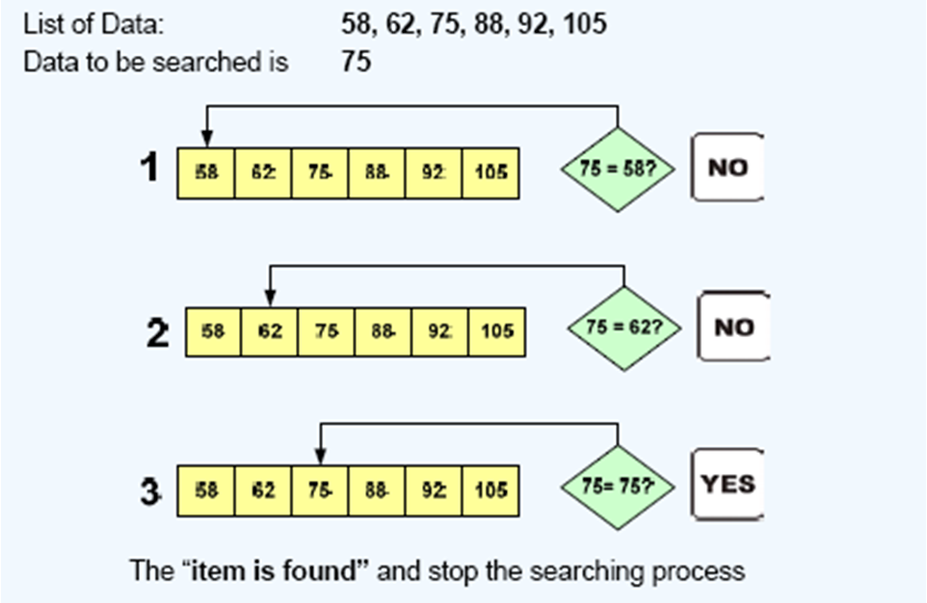
Linear search- illustration 1
Notes:
The Linear Search is applied on the set of items that are
not arranged in any particular order
In linear search , the searching process starts from the
first item.
The searching is continued till either the item is found or
the end of the list is reached indicating that the item is
not found.
The items in the list are assumed to be unique.

Slide 10
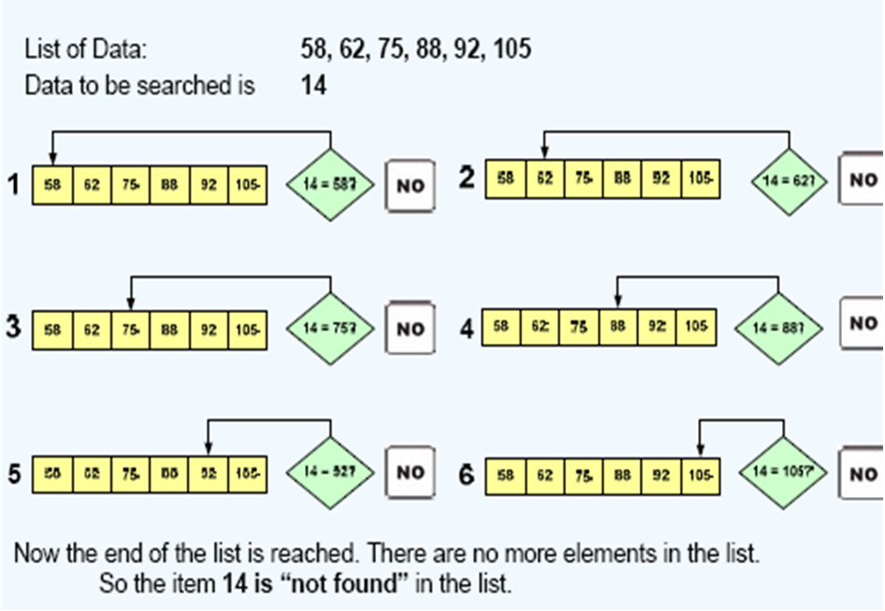
Linear search- illustration 2
Notes:
The Linear Search is applied on the set of items that are
not arranged in any particular order
In linear search , the searching process starts from the
first item.
The searching is continued till either the item is found or
the end of the list is reached indicating that the item is
not found.
The items in the list are assumed to be unique.

Slide 11
Pseudo code for linear search
int found=0; //setting flag
Print "enter no of numbers";
Input n;
for(i=0;i<n;i++){
Print “enter number\n";
Input a[i]; // entered data items
}
Print “enter the element to be searched";
Input key; // data to be searched
/*search procedure*/
for(i=0; i<n; i++) {
if(a[ i ]==key) // comparison
{
found=1;
pos=i+1;
break;
} }
if(found==1)
Print“data_found_in”,pos,
"position";
otherwise
Print “data is not found“;

Slide 12
Sorting Techniques L17-L18
Notes:
Bubble sort, sometimes referred to as sinking sort/ripple sort, is a simple sorting algorithm that works by repeatedly stepping through the list to be sorted, comparing each pair of adjacent items and swapping them if they are in the wrong order.

Slide 13
Objectives
To learn and appreciate the following concepts
Sorting Technique
Bubble Sort

Slide 14
Sorting
Arrangement of data elements in a particular order
Bubble sorting
Notes:
Bubble sort, sometimes referred to as sinking sort/ripple sort, is a simple sorting algorithm that works by repeatedly stepping through the list to be sorted, comparing each pair of adjacent items and swapping them if they are in the wrong order.

Slide 15
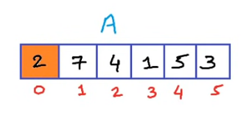
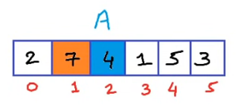
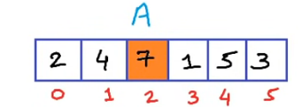
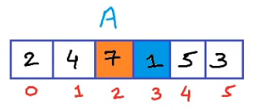
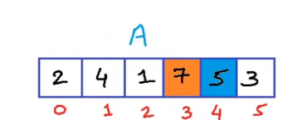
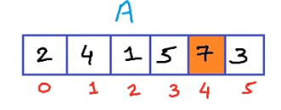
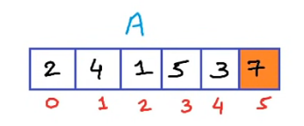
Pass 1:

Slide 16
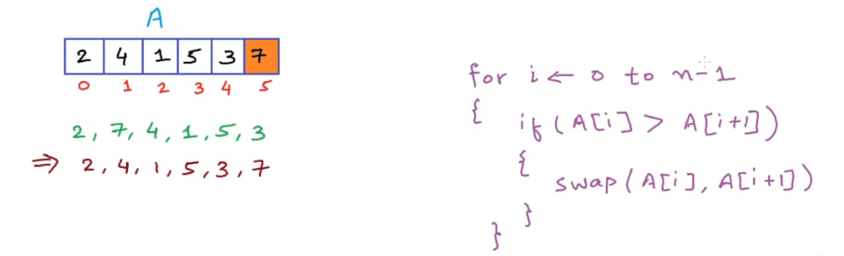
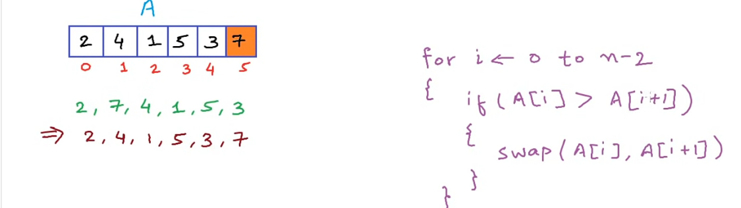

Slide 17
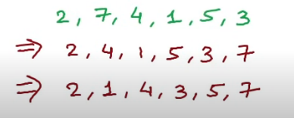
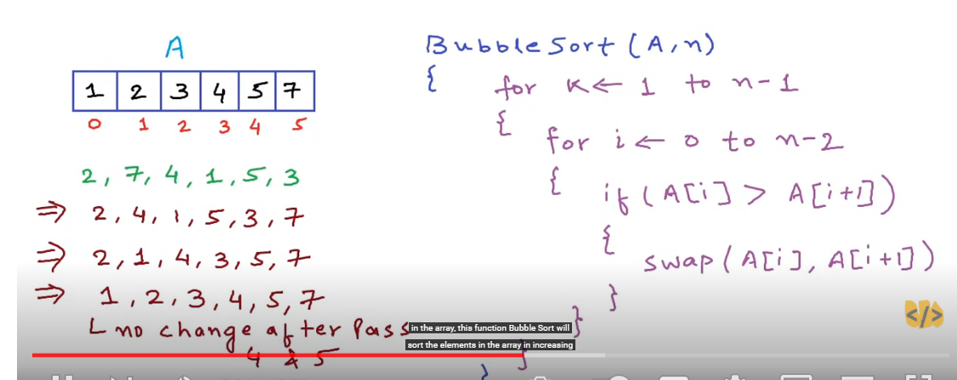

Slide 18
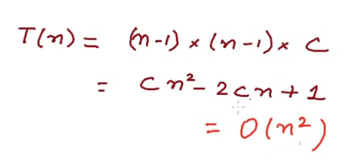

Slide 19
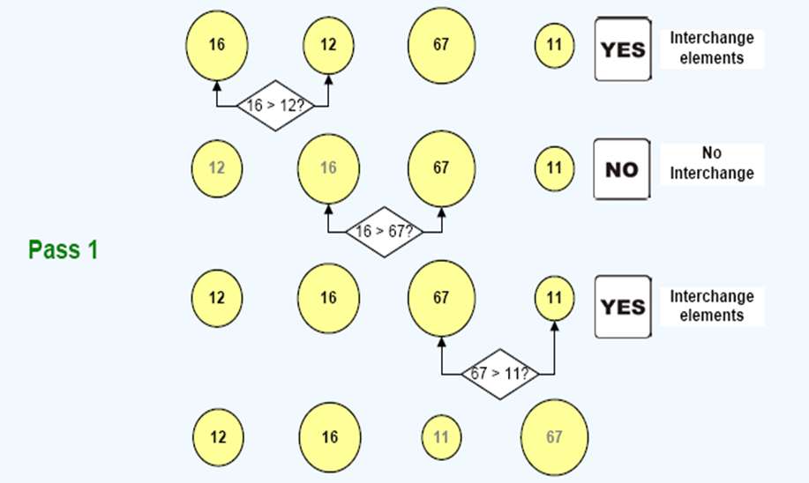
Bubble Sort- Illustration

Slide 20
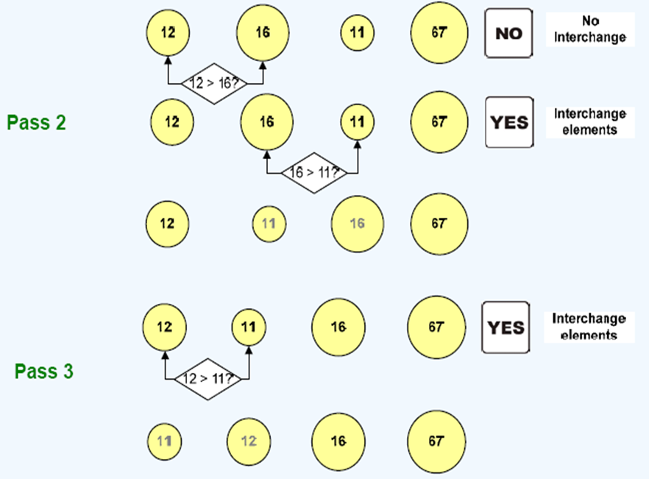
Bubble Sort- Illustration

Slide 21
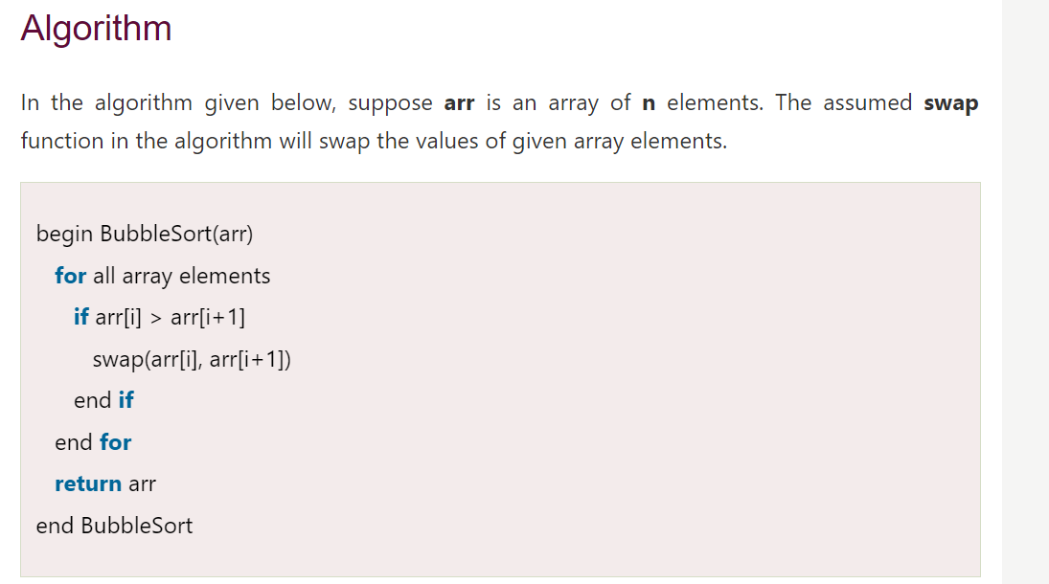
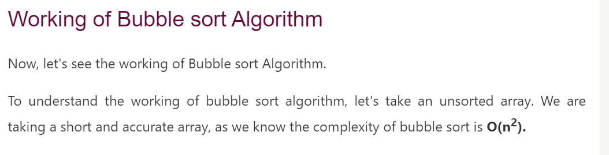

Slide 22
Pseudo code for Bubble Sort procedure
for(i=0;i<n;i++)
Input a[i]; // entered elements
for(i=0;i<n-1;i++) //pass
{ for(j=0;j<n-i-1;j++)
{ if(a[j]>a[j+1]) // comparison
{ // interchange
temp=a[j];
a[j]=a[j+1];
a[j+1]=temp;
}
}
}
Example :
a[ ]={16, 12, 11, 67}
Array after sorting (ascending) a[ ]={11, 12, 16, 67}

Slide 23
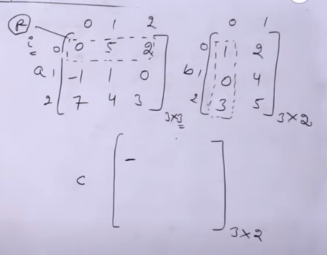

Slide 24
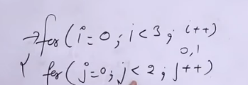
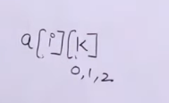
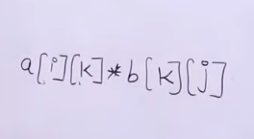

Slide 25
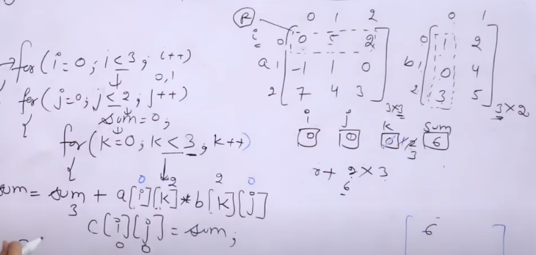
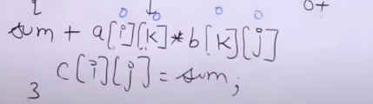

Slide 26
Array multiplication in Two-Dimensional Array using Array in C
#include<stdio.h>
int main() {
int a[10][10], b[10][10], c[10][10], n, i, j, k;
printf("Enter the value of N (N <= 10): ");
scanf("%d", & n);
printf("Enter the elements of Matrix-A: \n");
for (i = 0; i < n; i++) {
for (j = 0; j < n; j++) {
scanf("%d", & a[i][j]);
}
}

Slide 27
printf("Enter the elements of Matrix-B: \n");
for (i = 0; i < n; i++) {
for (j = 0; j < n; j++) {
scanf("%d", & b[i][j]);
}
}
for (i = 0; i < n; i++) {
for (j = 0; j < n; j++) {
c[i][j] = 0;
for (k = 0; k < n; k++) {
c[i][j] += a[i][k] * b[k][j];
}
}
}

Slide 28
printf("The product of the two matrices is: \n");
for (i = 0; i < n; i++) {
for (j = 0; j < n; j++) {
printf("%d\t", c[i][j]);
}
printf("\n");
}
return 0;
}

